Slide 1
Restaraunt Capacity Tracker: UI Improvements
Olivia Zhang
June 2, 2015
Computer Systems research lab

Slide 2
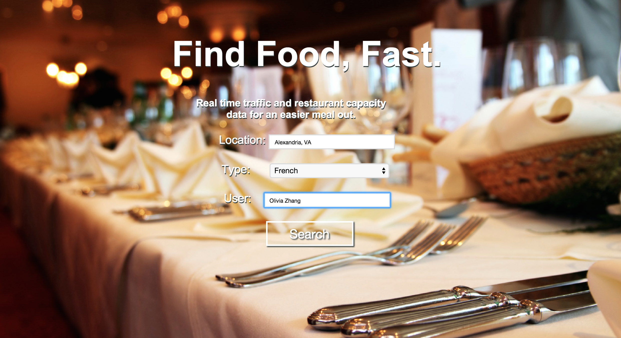
Opening Page: If required values left blank, application uses default values (“Fairfax” and “Sushi”)

Slide 3
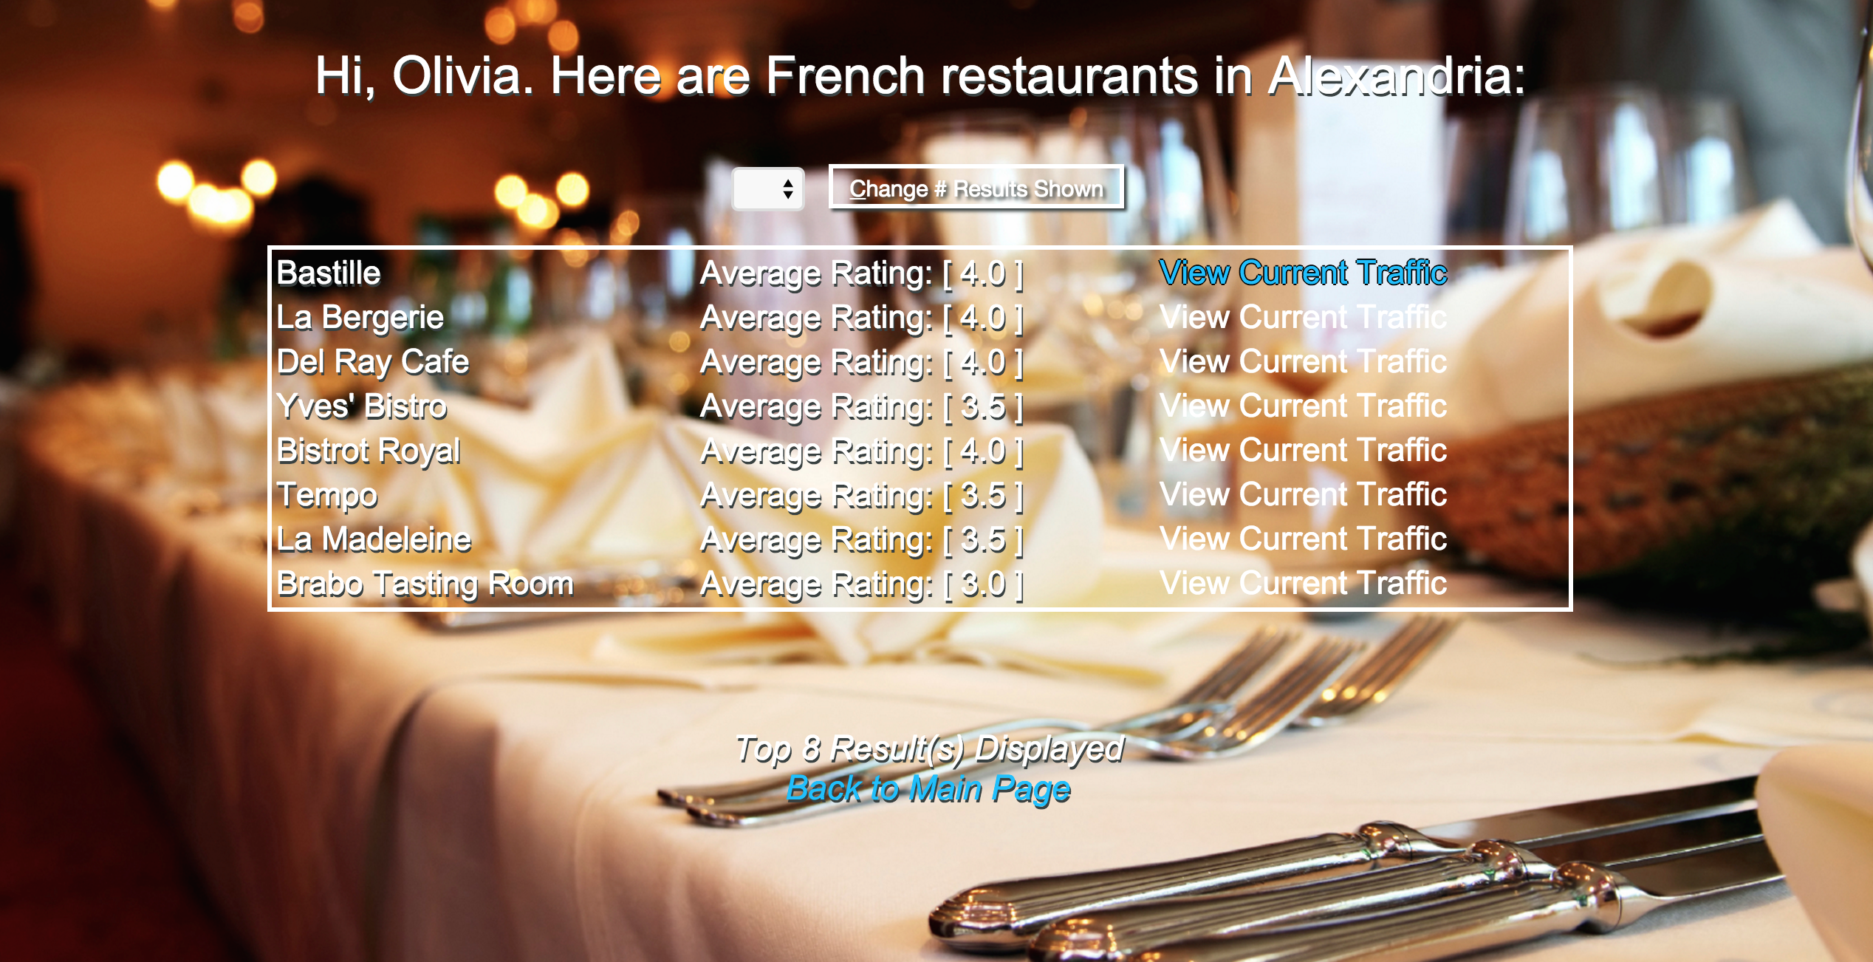
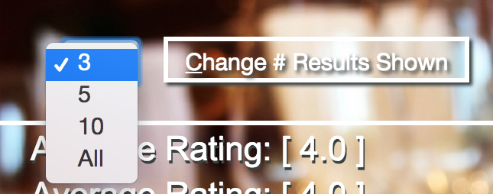
Expandable table to control number of results shown
Links become bright blue when moused over

Slide 4
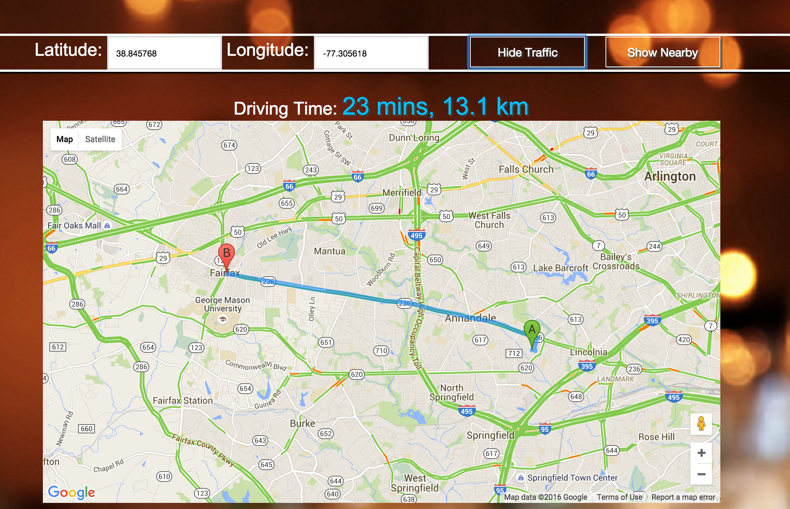
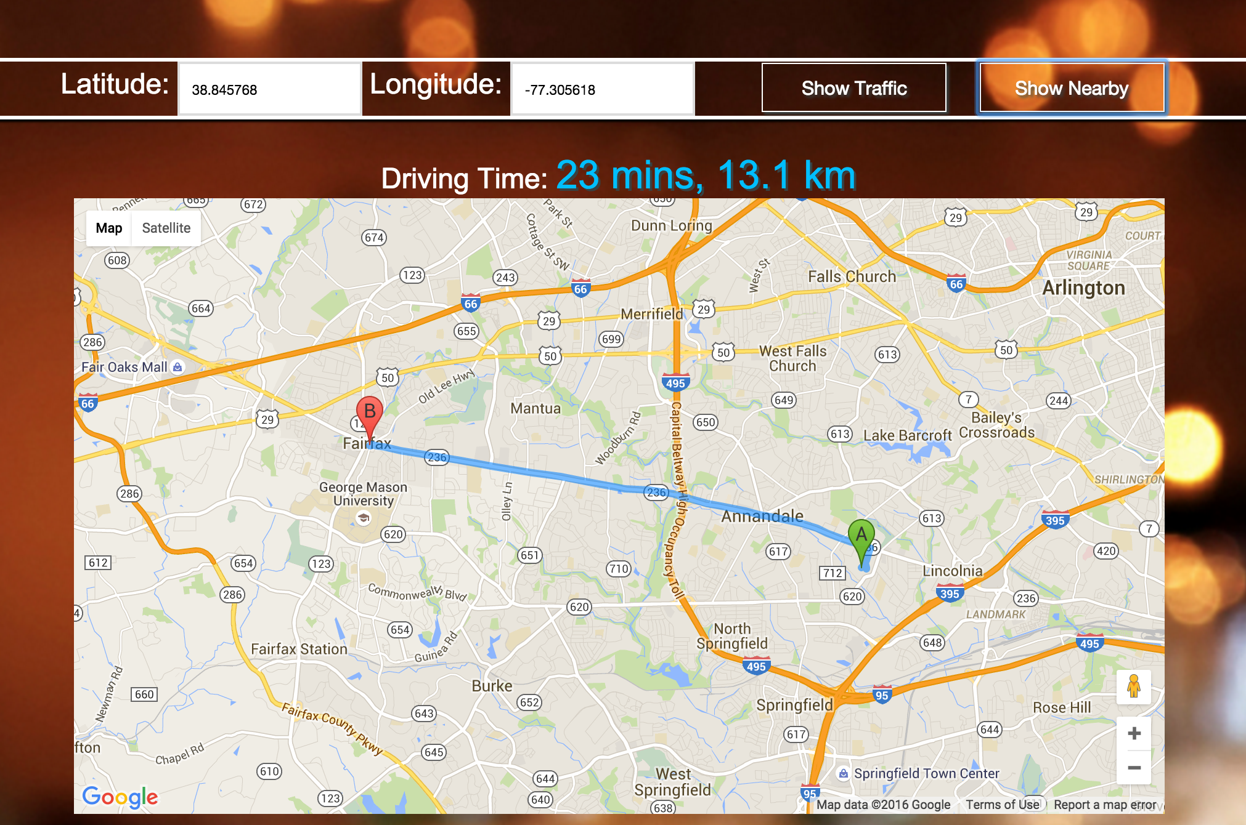
Traffic toggle button; button changes text accordingly
Route Calculation (automatic location currently is TJHSST) with detailed driving directions displayed directly underneath

Slide 5
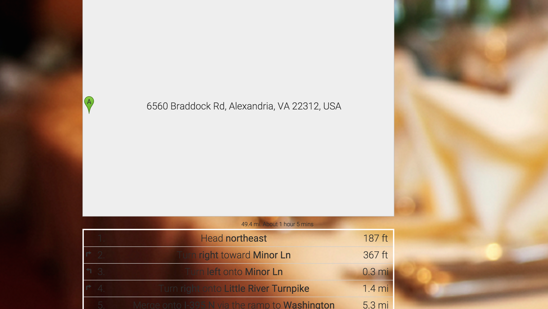
Detailed driving instructions

Slide 6
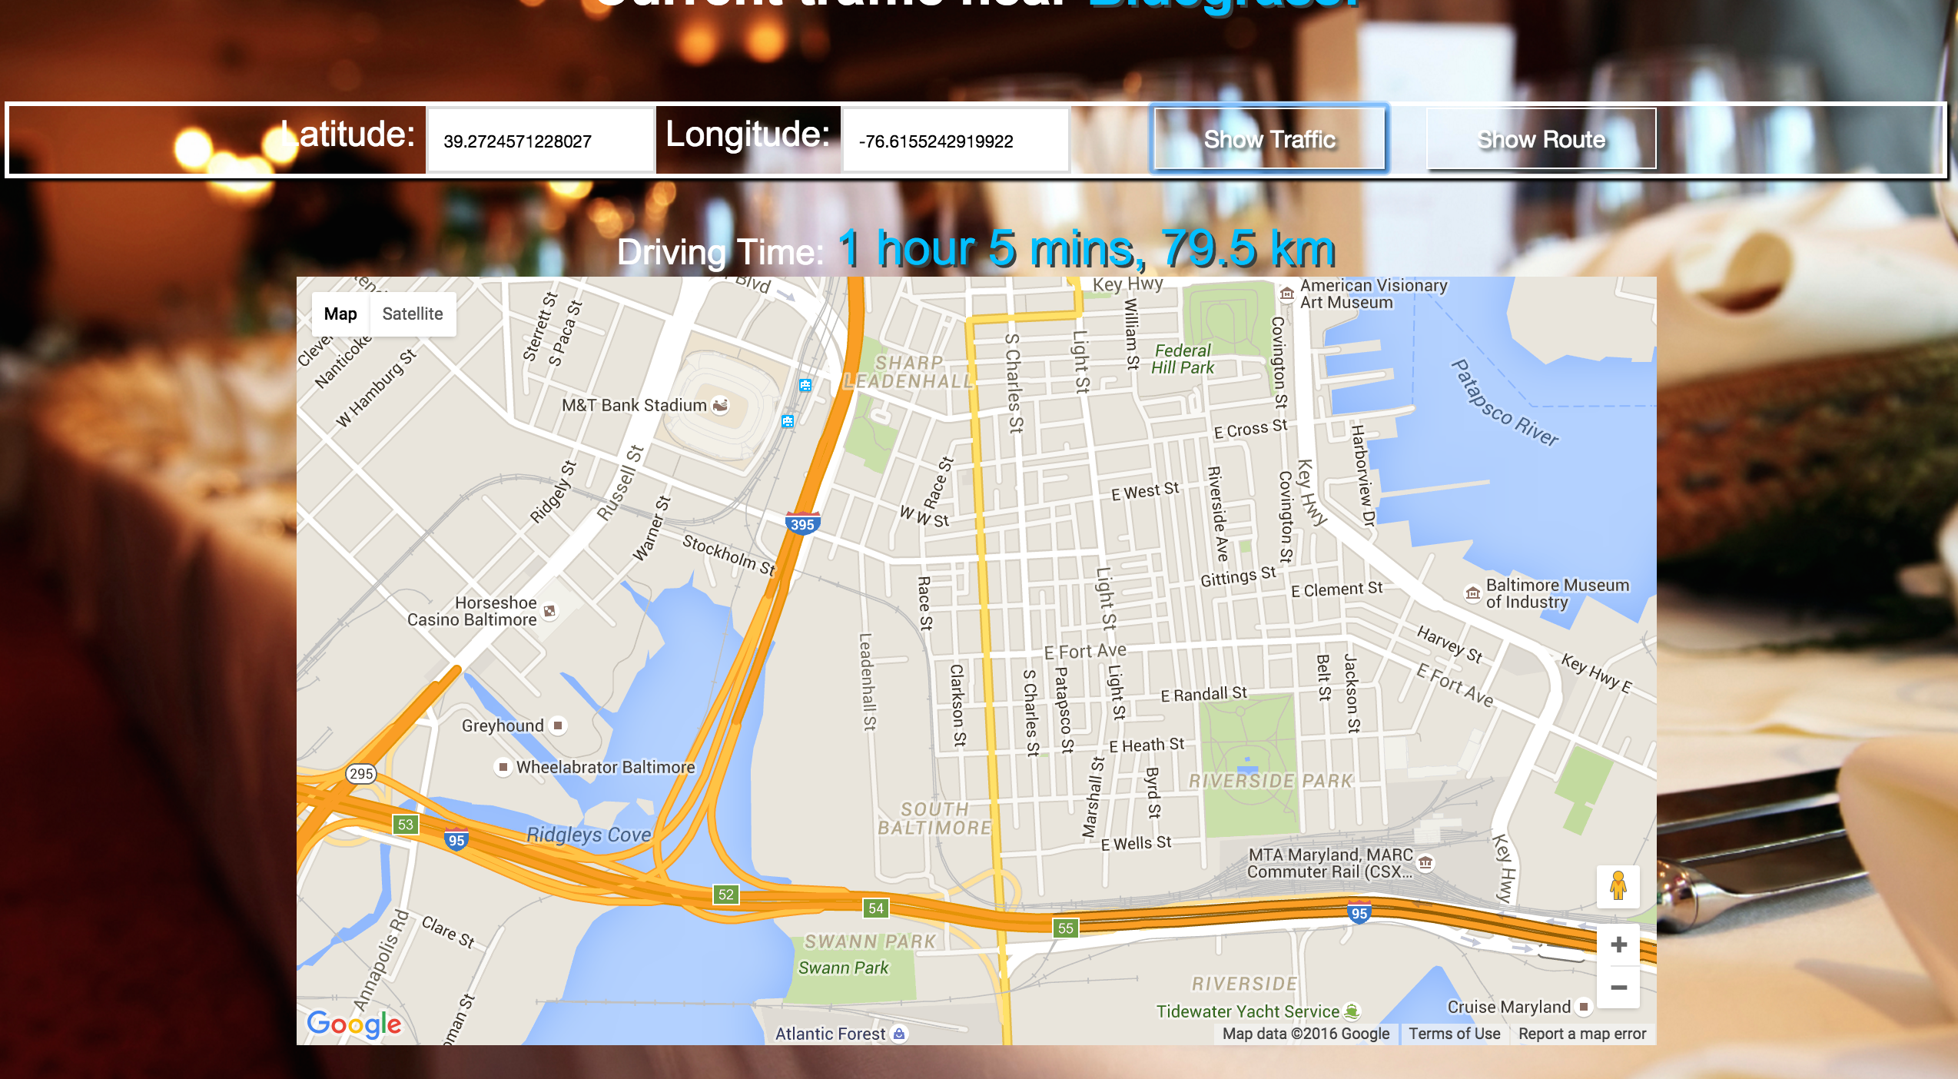
Option to toggle between route view and nearby traffic view

